Slide 1
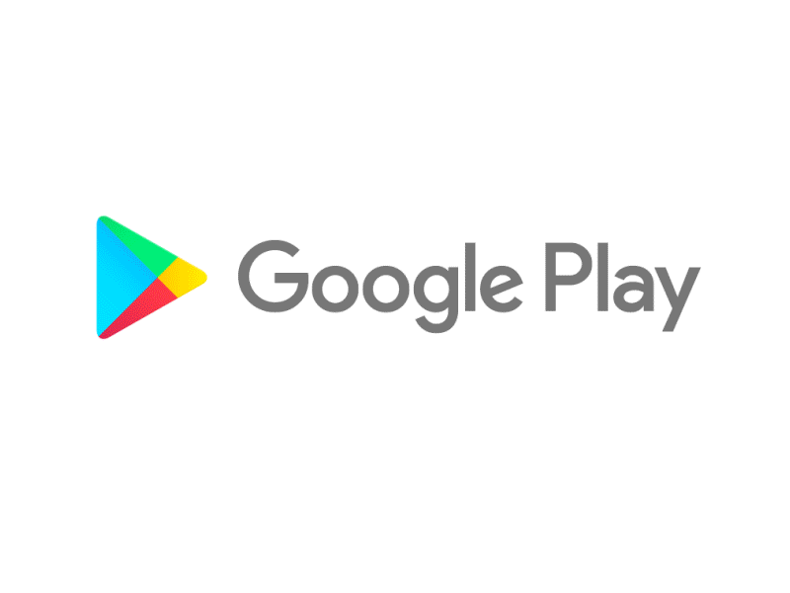
Capstone Project
Play Store App Review Analysis
By
Sameer khan
Data Science Trainee, AlmaBetter

Slide 2






WHY ANALYZE THE GOOGLE PLAY STORE?
Mobile App Market is set to grow 20% by 2023
Android Apps comprise 90% of the Mobile App Market
What makes an App popular? Can we predict how popular it’s going to be?
What are some interesting patterns in user behavior related to app usage & feedback?

Slide 3


Introduction
Android is the most popular operating system in the world, with over 2.5 billion active users spanning over 190 countries.
Google Play was launched on March 6, 2012, bringing together Android Market marking a shift in Google's digital distribution strategy .
Android is the dominant mobile operating system today more than 85% of all mobile devices running Google’s OS. The Google Play Store is the largest and most popular Android app store.
There are more than 3.04 million apps found on Google Play Store.
The Play Store apps data has enormous potential to drive app-making businesses to success.
Actionable insights can be drawn for developers to work on and capture the Android market. The main goal of our project is-
The purpose of our project is to gather and analyze detailed information on apps in the Google Play Store in order to provide insights on app features and the current state of the Android app market.
The Objective of the project to Explore and analyze the data to discover key factors responsible for app engagement and success.

Slide 4


Problem Statement
Problem Statement
Two datasets are provided, one with basic information and the other with user reviews for the respective app.
We must examine and evaluate the data in both datasets in order to identify the important characteristics that inﬂuence app engagement and success.
So, what factors inﬂuence an app's success?
An app is said to be successful if it has:
A high average user rating
A good number of positive reviews
A good number of monthly average users
High revenue per customer and so on.

Slide 5


Agenda
Introduction
Category wise play store apps installs
Category wise most popular apps
Top 10 apps in play store considering all the parameters
Average installs, category wise
Most installed apps in communication category
Average sizes of apps in each category
Category wise percentage of paid apps
Category wise top installed paid apps
Average rating of paid apps
Correlation between Rating ,Installs and Price
Category wise installed apps with content rating
Percentage reviews sentiment distribution

Slide 6

Dataset Preparation
Loading the data sets: Two datasets, First Play store app
dataset and User Reviews dataset.
Import Libraries: NumPy, Pandas, Seaborn and Matplotlib
Data cleaning: Null values, Finding and removing Outliers, Removing duplicate data.
Data Imputation: Filling the missing categorical values with mode and numerical values with median. Conversion of price, installs, reviews into numerical values.
Exploratory Data Analysis: Analyzing the data sets to summarize their main characteristics using statistical graphics and data visualizations method.

Slide 7
1.App : This column Contains the name of the app for each observation. 2.Category : This column Contains Category to which the app belongs. 3.Rating : This column contains the average rating for the app. 4.Reviews : This column contains the number of reviews that the app has received on the play store. 5.Size : This column contains the amount of memory the app occupies on the device. 6.Installs : This column contains the number of times that the app has been downloaded and installed from the play store. 7.Type : This column contains the information whether the app is free or paid. 8.Price: If the app is a paid app, this column contains the data about its price. 9.Content Rating: This column contains the maturity rating of the app i.e. the age group of the audience for which it is suitable. 10.Genres: This column contains the data about to which genre the app belongs. Genres can be considered as a further division of the group of Category. 11.Last Updated: Contains the date on which the latest update of the app was released. 12.Current Version: Contains information on the current version of the app available on the play store. 13.Android Version: Contains information about the android versions on which the app is supported.
Features in Google Play store Data

Slide 8

Attributes in User reviews
App- Application name
Translated Review- User review
Sentiment- Positive/Negative/Neutral
Sentiment Polarity- Sentiment polarity score
Sentiment Subjectivity- Sentiment subjectivity score

Slide 9



OVERVIEW OF ANALYSIS
Data Cleaning
Data Exploration
Predictive Modeling
Understand the structure of the dataset and clean data before analysis
Uncover initial patterns, characteristics, and points of interest using visual exploration
Formulate a statistical model to forecast an outcome using relevant predictors

Slide 10
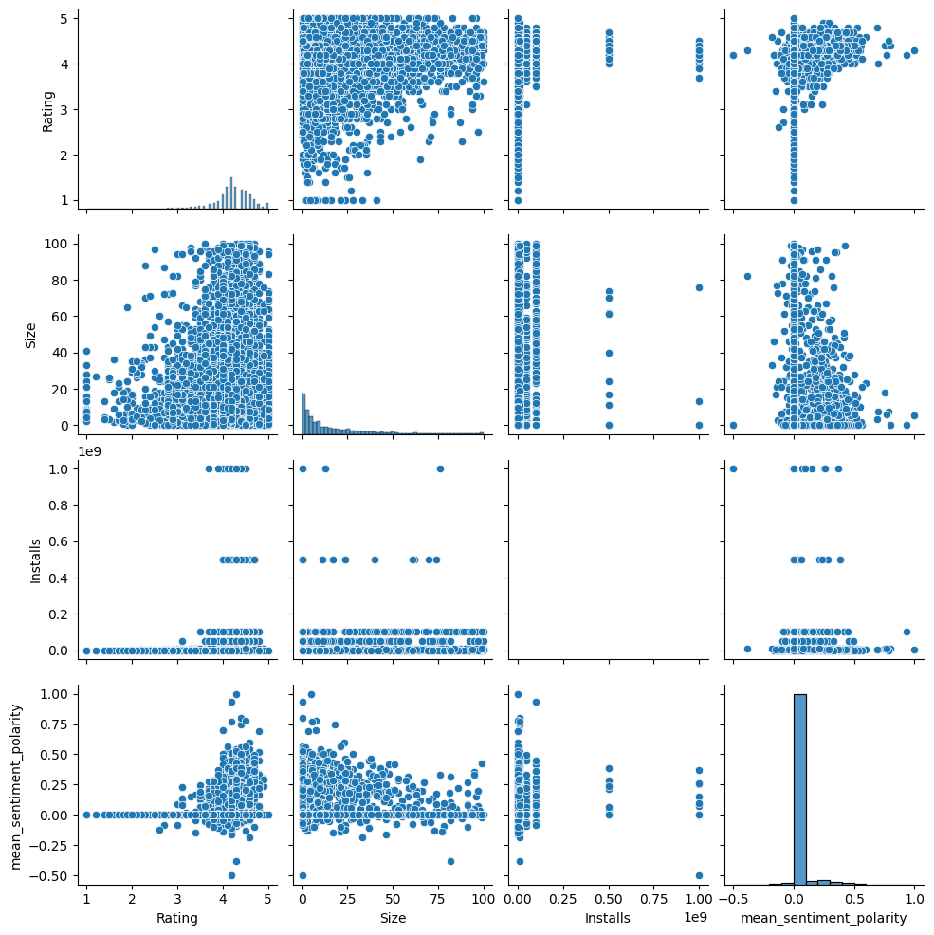
Pair Plot-Category ,Rating, Size, Installs, sentiment polarity

Slide 11
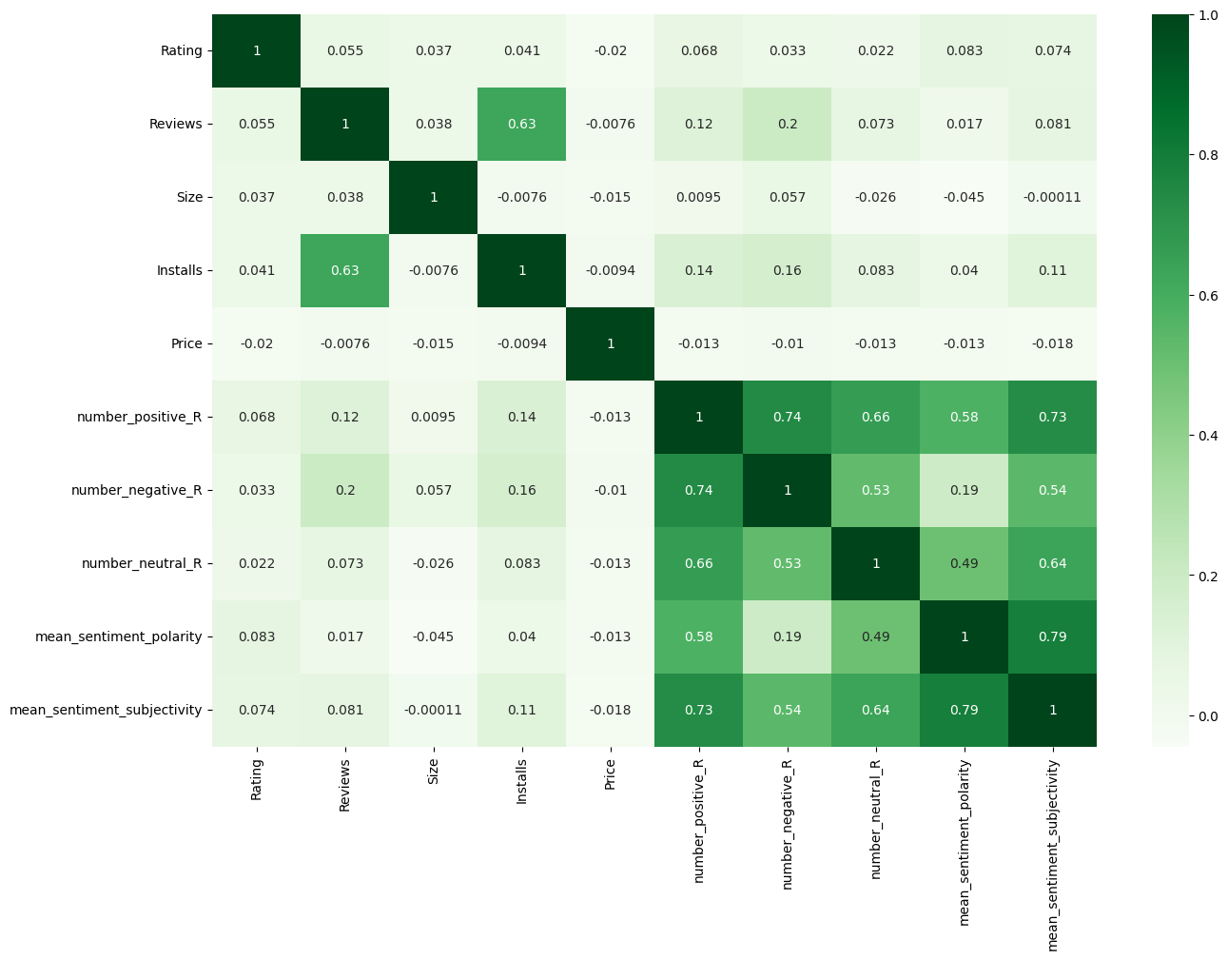
Correlation Heatmap
❏ There is a strong positive correlation between the Reviews and Installs.
❏ The price is slightly negatively correlate with the Rating, Reviews, Installs.
❏ The Rating is slightly Positively correlated with Installs and Reviews.
❏ number_postive_R, number_negative_R , number_nuetral_R is strongly correlated to each other.

Slide 12
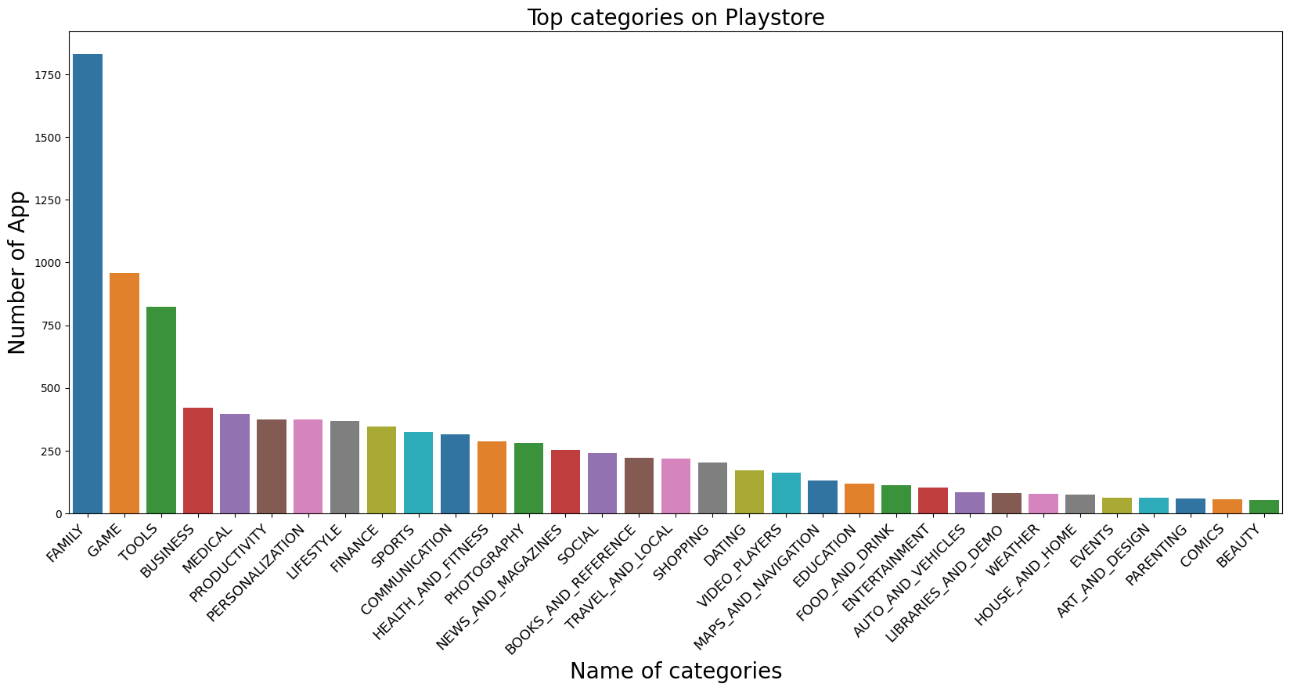

Top categories on Google Playstore.
There is total 33 Categories in play store dataset.
Out of that Family, Game, Tools is highly effective Categories.
Family have more than 1750 apps, approx 1000 apps are in Game and 750 apps in Tools Category.

Slide 13
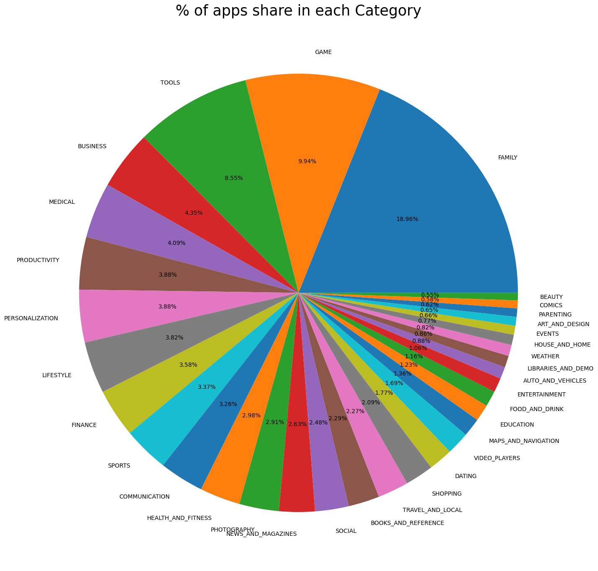
% of apps share in each categories.
❏ Here we can see that highest number of percentage of app is belongs to GAME,FAMILY AND TOOLS categories.
❏ Family have 18.96 , Game have 9.94 and Tools have 8.55 percentage of Apps share and these three Apps have total 37.45 percent share.

Slide 14
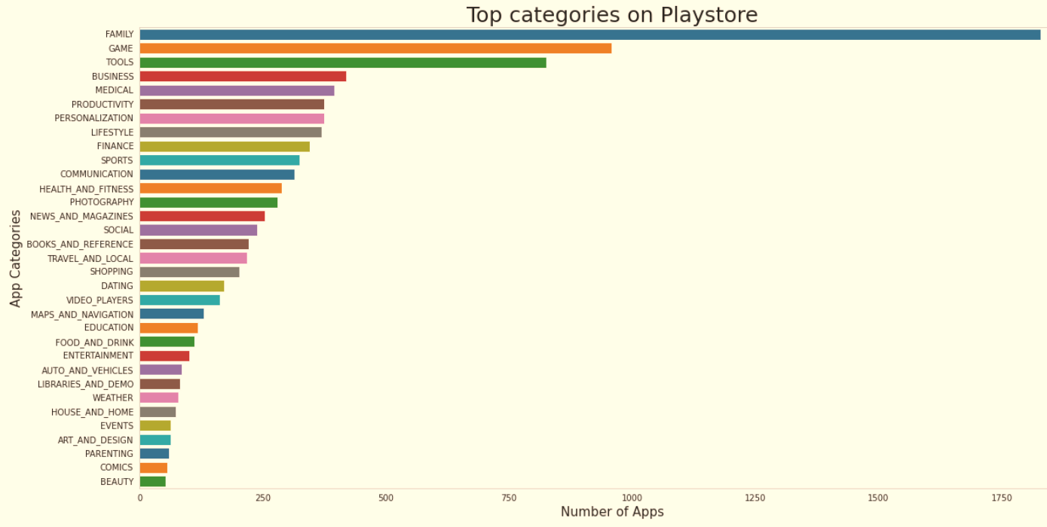
Count of Applications in each category
Family and Game apps have the
highest market prevalence. Surprising Tools, Business and Medical apps are also at the Top Count of applications.

Slide 15
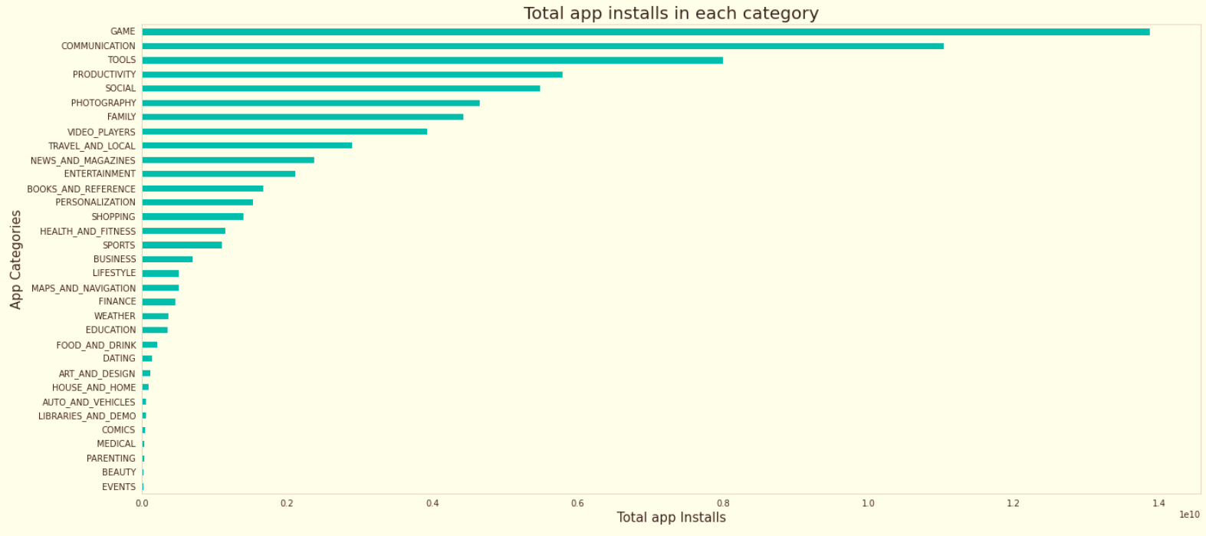
Category App's have most number of installs
The Game, Communication and Tools categories has the highest number of installs compared to other categories of apps.

Slide 16
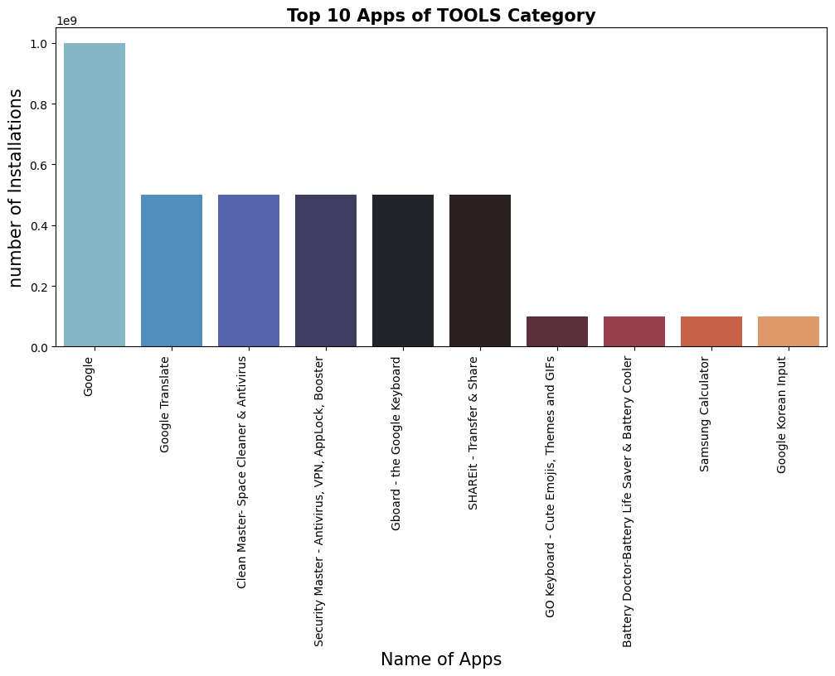
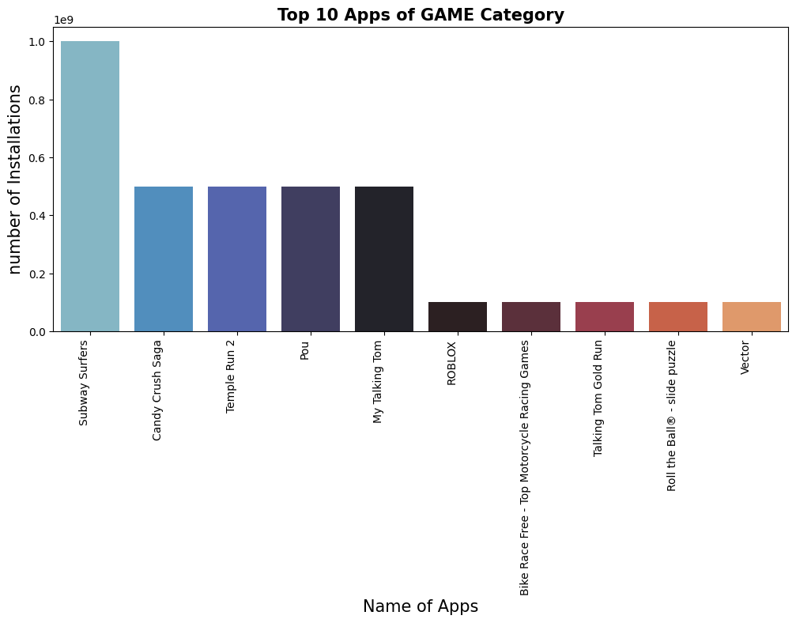
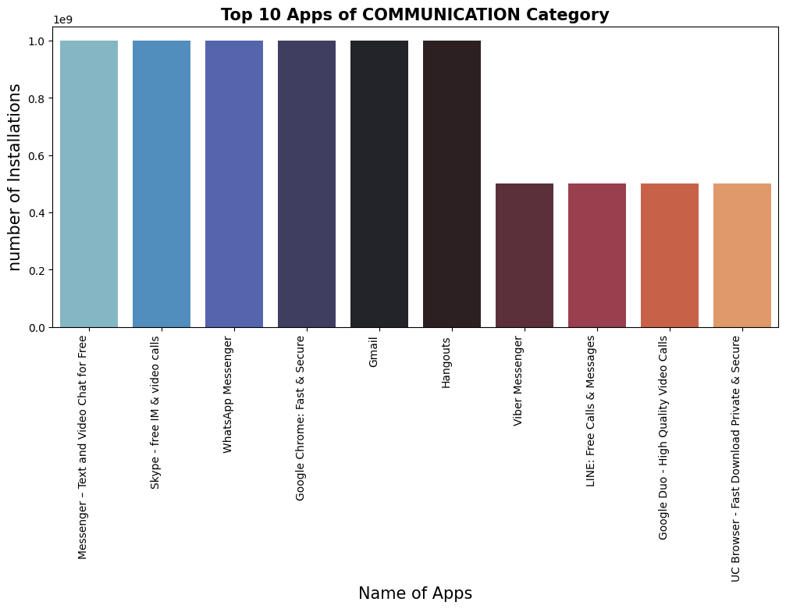
Top 10 Apps in top 3 categories.
This graph shows the top installed apps in the ‘Games’ category. Further looking into the play store reveals that these apps are light, casual, single player games.
This graph shows the top installed apps in the communications category.
This graph shows the top installed apps in the ‘Tools’ category.

Slide 17
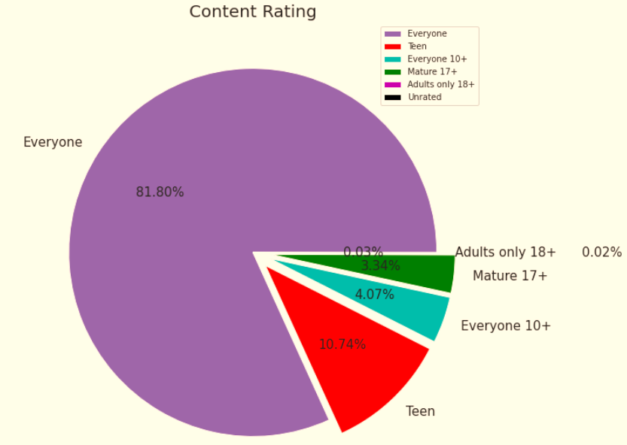
Content Rating
From the above plot we can see that Everyone category having majority of apps count.
A majority of the apps (81.80%) in the play store are can be used by everyone. The remaining apps have various age restrictions to use it.

Slide 18
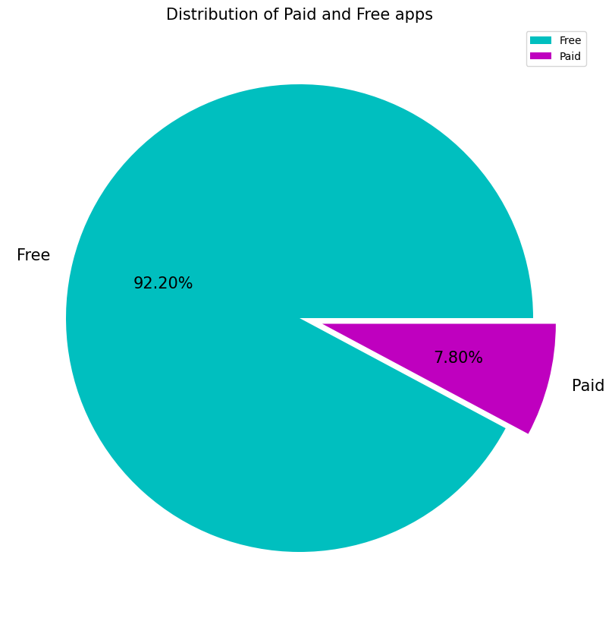
The ratio of Paid apps and Free apps.
From the above graph we can see that 92% of apps in google play store are free and 8%are paid.

Slide 19
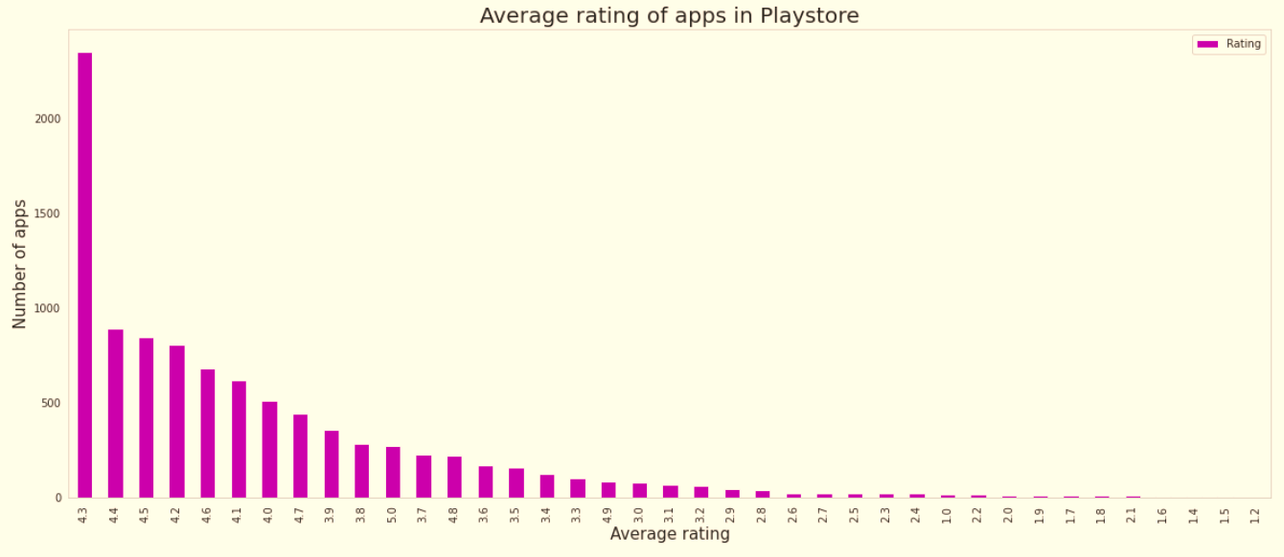
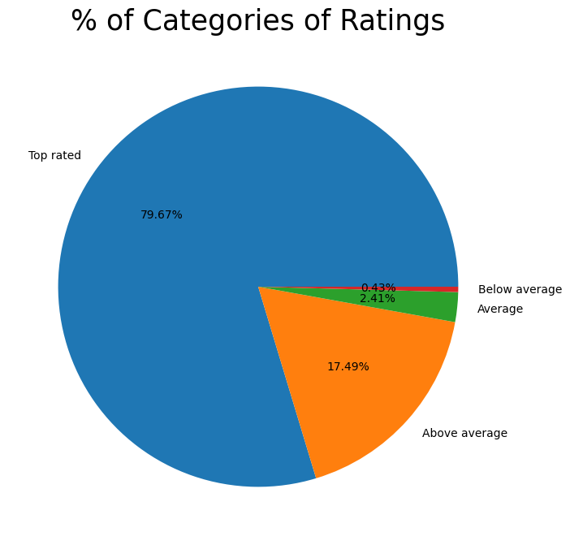
Average rating of the apps
The average user rating is divided into 4 categories:
Rating: 4-5 ⇒ Top Rated
Rating: 3-4 ⇒ Above Average
Rating: 2-3 ⇒ Average
Rating: 1-2 ⇒ Below Average
The majority of the apps in the Play Store (~80%) are top rated.
This implies that the majority of the users are happy with the services received via the respective app.

Slide 20
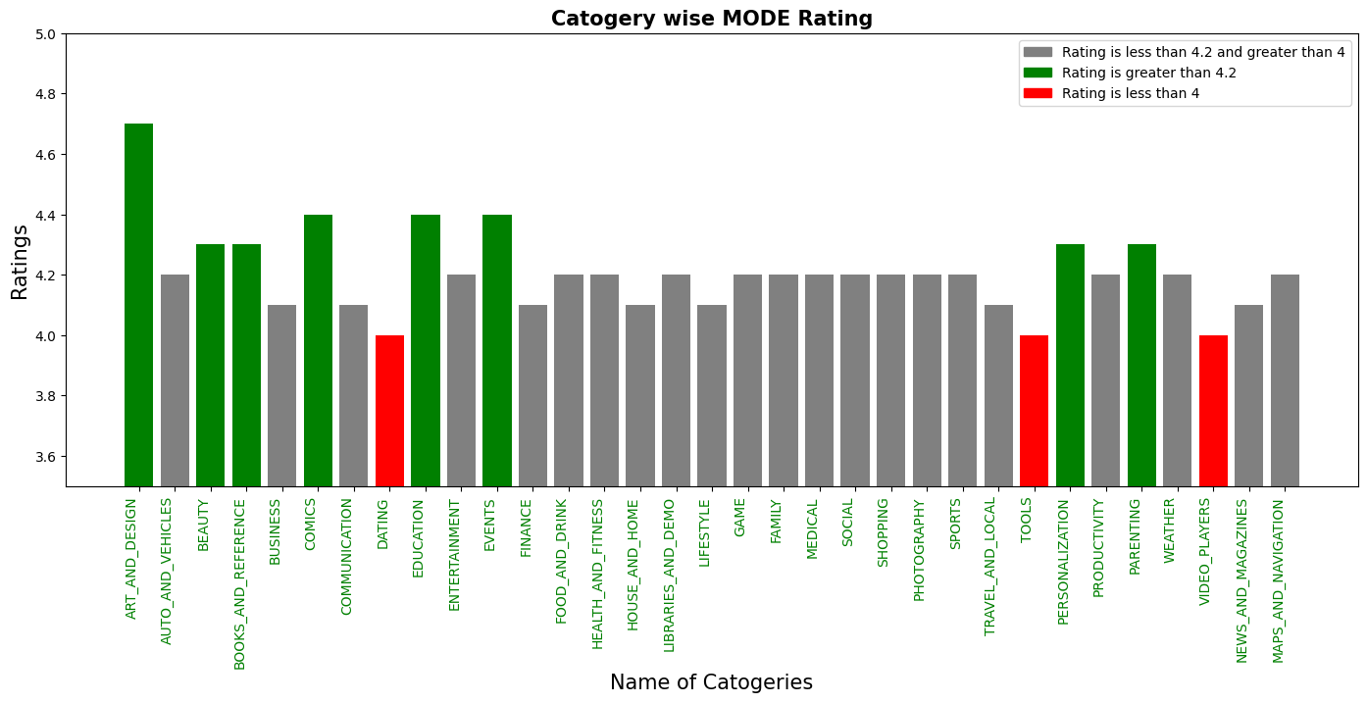
Category wise mode rating.
Mode rating- this shows, which Rating is given most of the time in that category.
ART_AND_DESIGN, COMICS, EDUCATION and EVENT categories are highest mode ratign, And DATING, TOOLS AND VIDEO_PLAYERS are least mode Ratings.

Slide 21
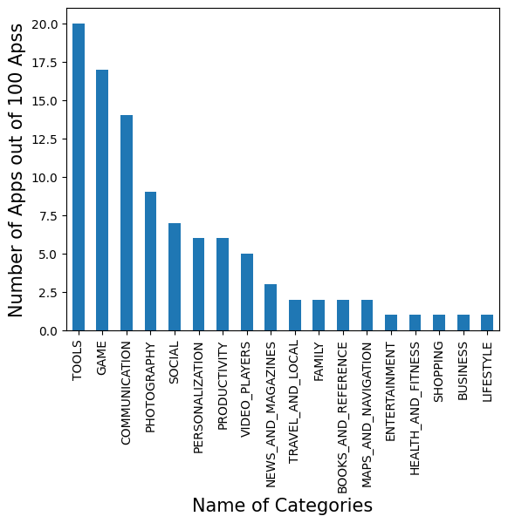
Name of categories which have highest number of top apps by installs.
There are a total 100 apps by installs free apps with over one billion installs.
The top categories in which these apps fall are Communication(16), game(17),Tools(20),photography(9) and social(7).

Slide 22
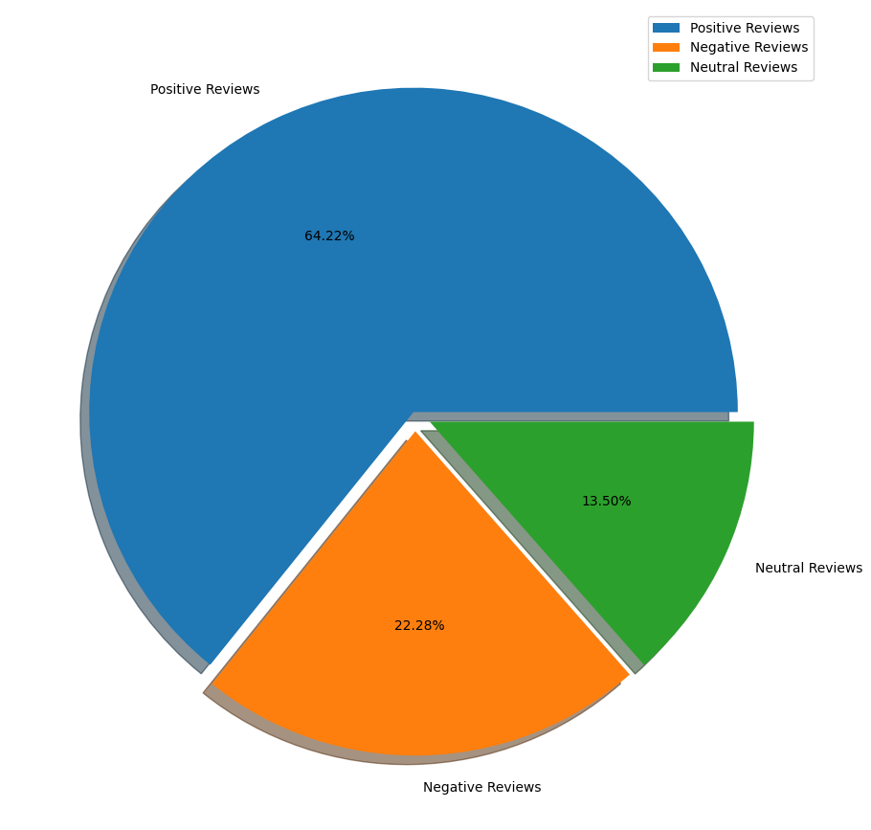
Percentage of Positive , Negative and Neutral Reviews in dataset.
◙ Positive reviews are 64.22%
◙ Negative reviews are 22.28%
◙ Neutral reviews are 13.50%

Slide 23
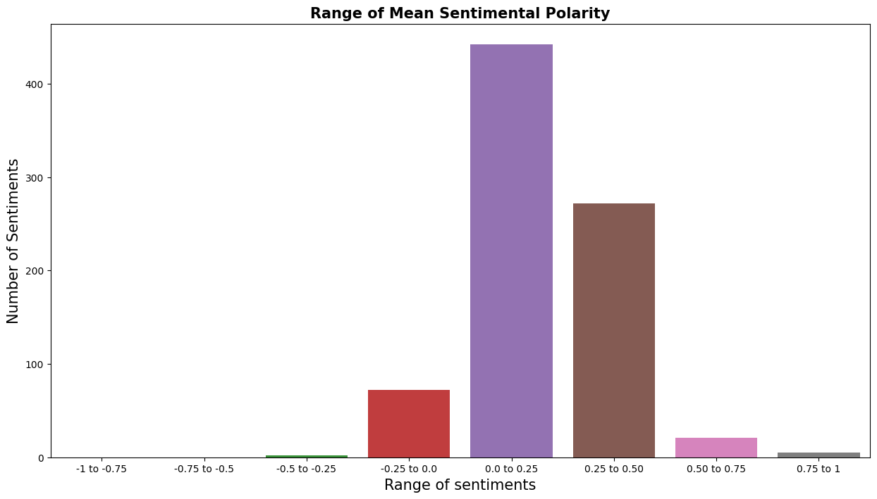
Number of sentiments in sentiment polarity range.
◙ This shows some range where sentiments Polarity are belongs .
◙ The sentiments Polarity is belongs -1 to 1.
◙ 90% of mean sentiments polarity is in between -0.25 to 0.50.

Slide 24
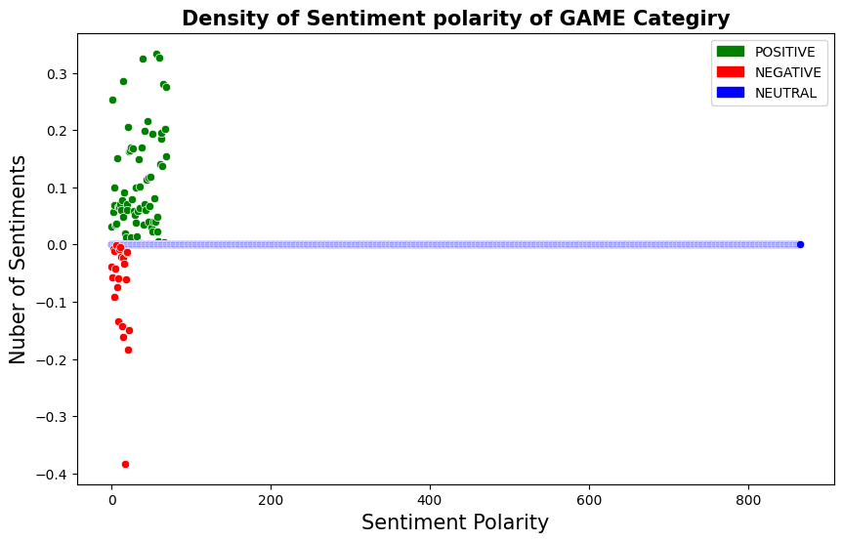
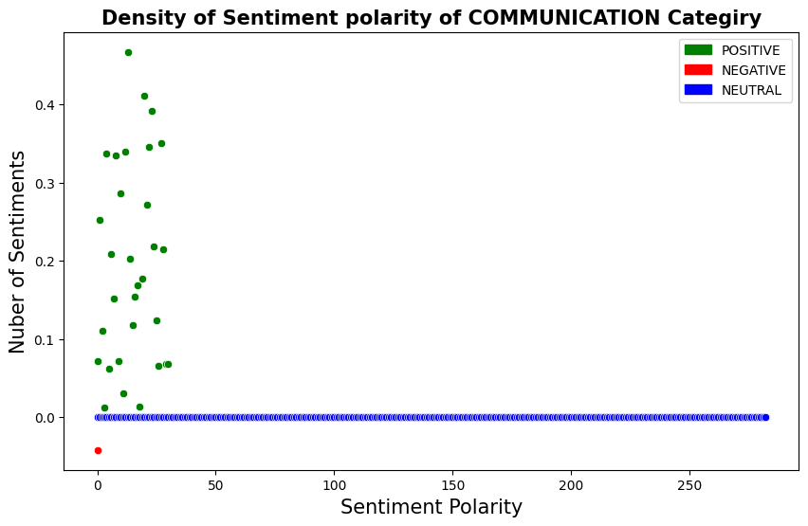
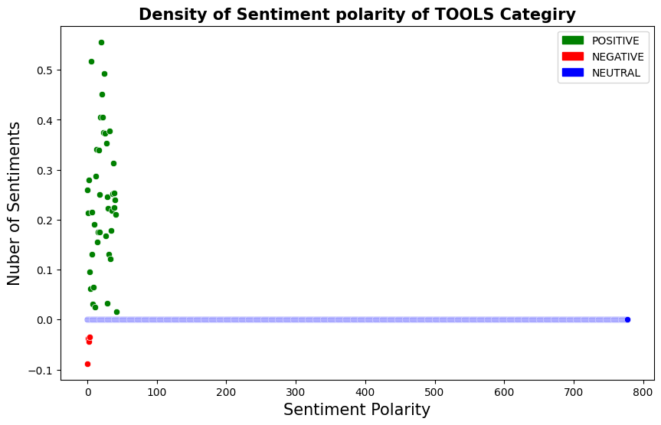
Density of Top 3 Categories Mean Sentiment polarity.
◙ Density of Top 3 Categories Mean Sentiment polarity, Here we can see that the density of positive polarity is high.

Slide 25
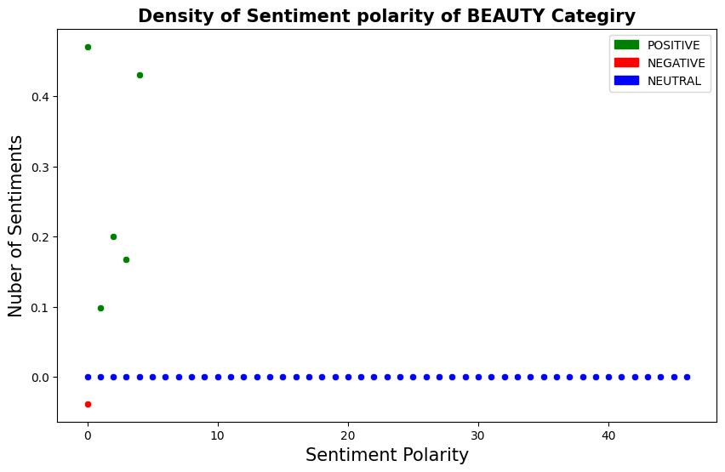
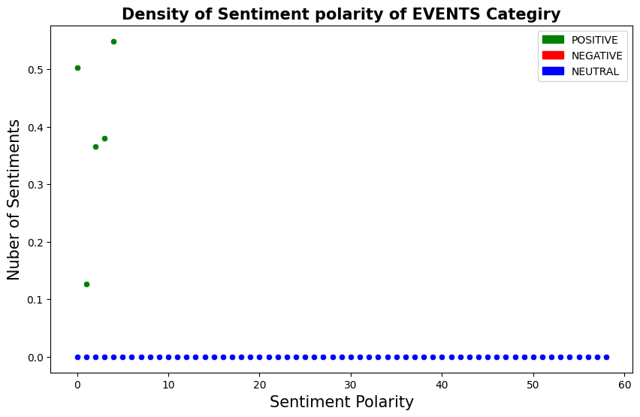
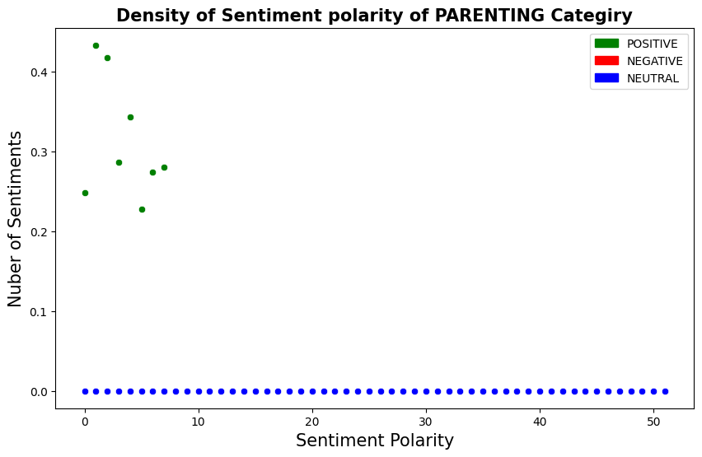
Density of Top 3 Categories Mean Sentiment polarity.
◙ Density of least 3 Categories Mean Sentiment polarity, Here we can see that their sentiment polarity are available but the density of positive polarity is very low.

Slide 26
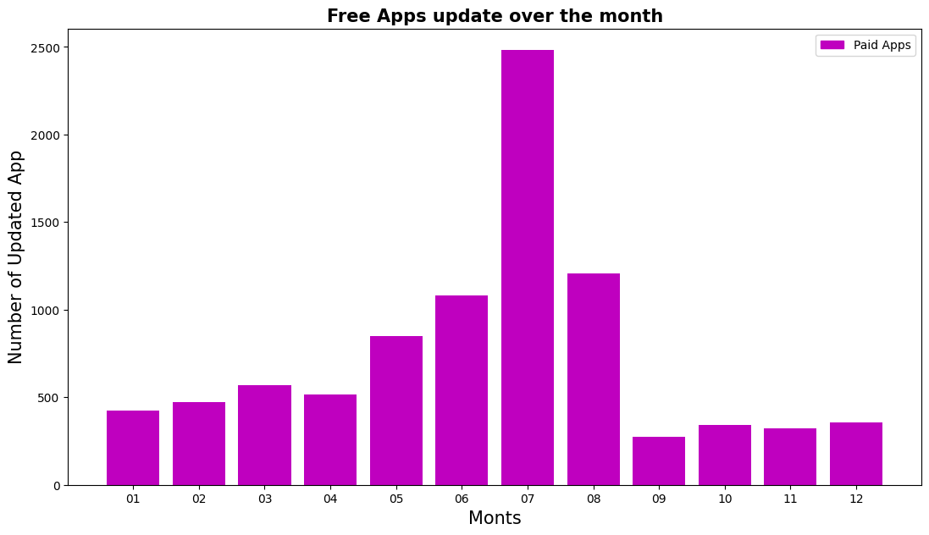
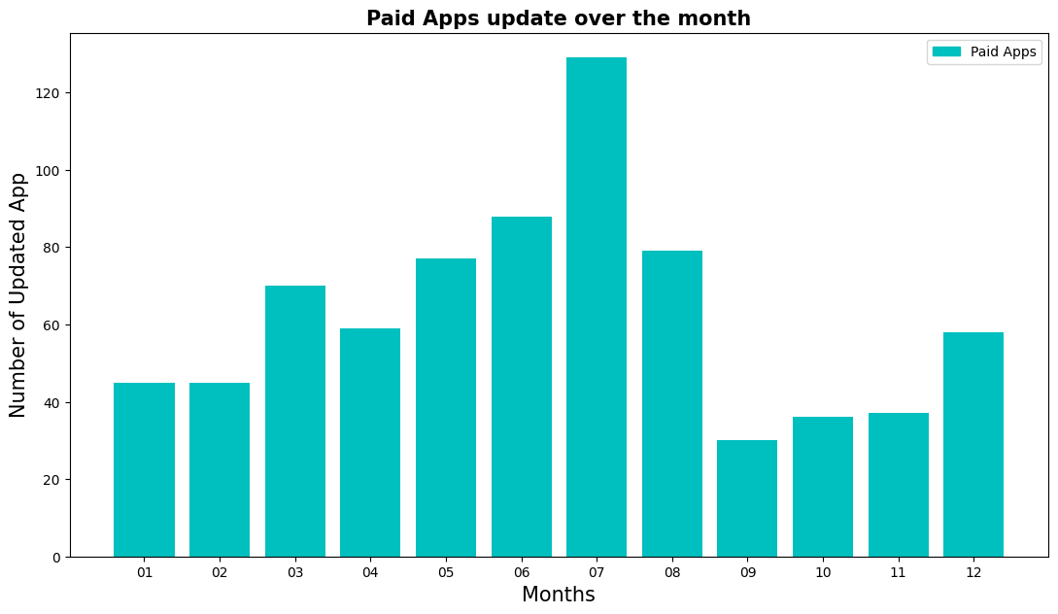
Apps updates in each month.
◙ The paid and free both type of Apps are mostly update in month of June to August but highly in the month of July.

Slide 27
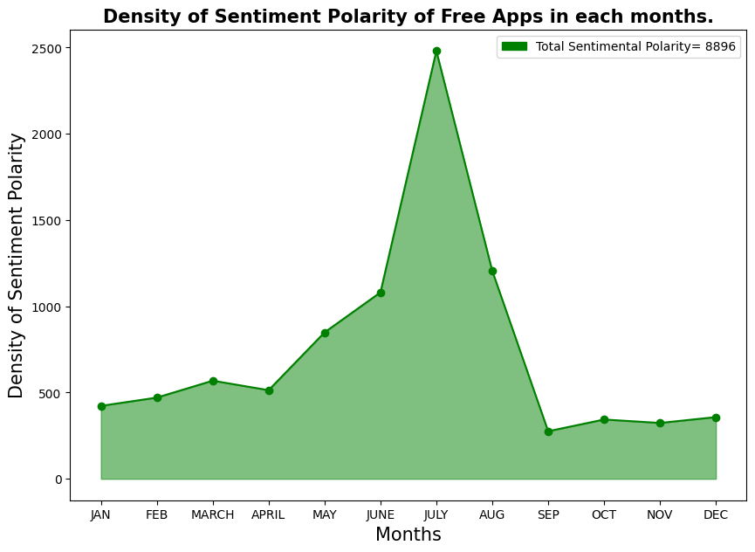
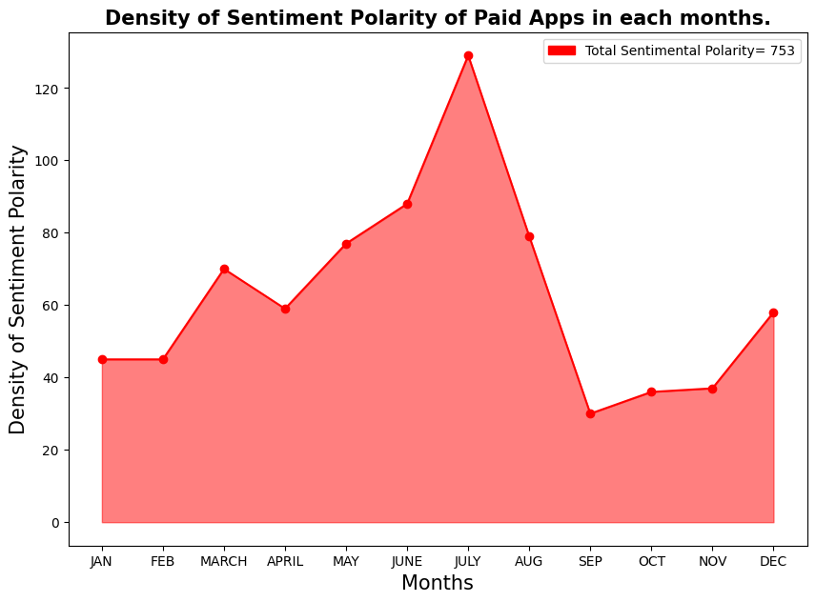
Density of Mean sentiment polarity in each months
◙ Density of sentiment polarity is high in Free Apps comparing to Paid Apps.
◙ In FREE Apps total 4800 out of 8896 sentiment are in month of June July and august it is more than 50 % . And paid Apps have total 300 out of 753 sentiment polarity in month of June, July and august it is approx 40 %.
◙ In month of JUNE, JULY and AUGUST density of sentiment polarity is high . This show that the Installs of Apps is higher in June and July than other months.

Slide 28
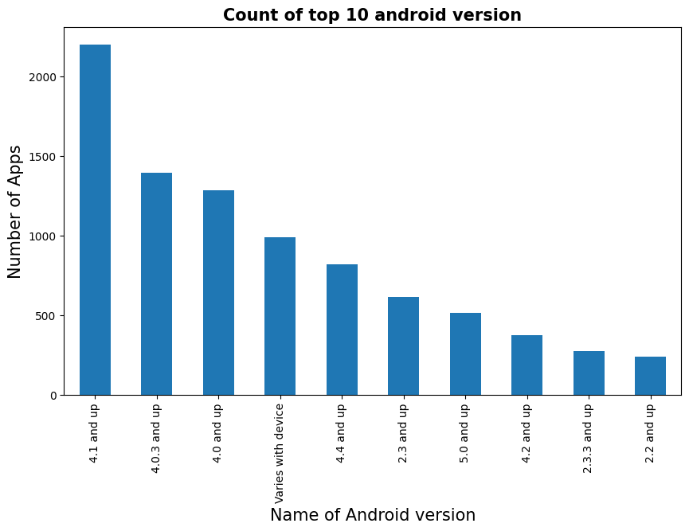
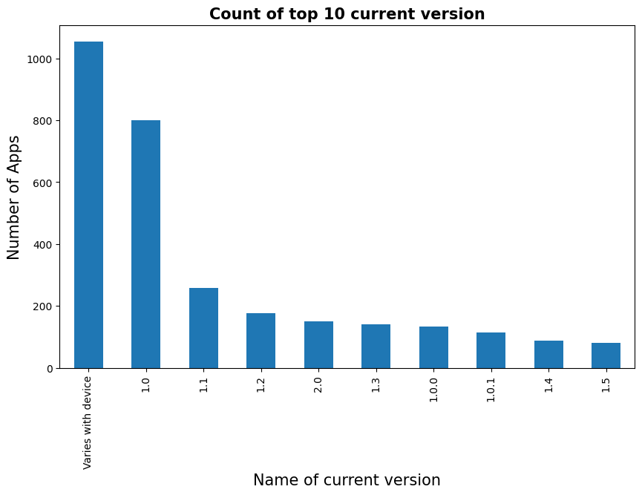
The number of top 10 Current versions Apps. And the number of apps in top 10 Android Versions.
◙ The Android Version of most of Apps is 4.1 and up .
◙ here we see the lost of apps is varies with device.

Slide 29
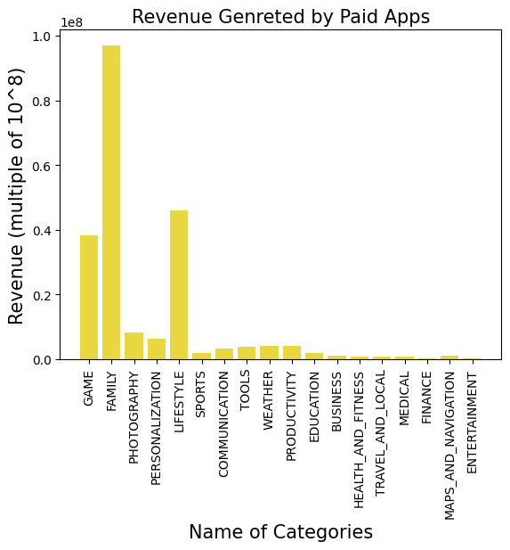
Top Paid Apps Based on Revenue Generated
Revenue generated is given by the formula:
Revenue = Installs * Price
Note that in this case, revenue refers to the money earned only from paid app installs.
The top categories in which these apps fall are Lifestyle, Family, and Game.
Minecraft, I am rich, and I am rich premium are the top paid apps based on revenue generated.
Family is the most revenue generating category in entire categories..

Slide 30

Challenges Faced
Challenges Faced
Reading the dataset and comprehending the problem statement.
Examining the business KPIs for app development and devising a solution to the problem.
Handling the error, duplicate and NaN values in the dataset.
Designing multiple visualizations to summarize the information in the dataset and successfully communicate the results and trends to the reader.

Slide 31
Conclusion’s
92.19% apps are Free and 7.81% apps are paid in type.
81.80% apps have Everyone content rating.
Events category has a highest mean rating of 4.39 and Dating category has lowest 4.05 rating.
Family, Game and Tools are top three categories having 1906, 926 and 829 app count.
Most competitive category: Family
Category with the highest number of installs: Game
Tools, Entertainment, Education, Business and Medical are top Genres.
8783 Apps are having size less than or equal to 50 MB.
7749 Apps has rating more than 4.0 including both type of app.
Overall sentiment count of merged dataset in which Positive sentiment count is 64%, Negative 22% and Neutral 14%.

Slide 32
Conclusion’s
It's good to develop a Free type app and having a content rating for Everyone.
Percentage of apps that are top rated = 81.80%
There are 20 free apps that have been installed over a billion times
Minecraft is the only app in the paid category with over 10M installs, and also has produced the most revenue only from installation fee.
Price, Rating, Size has no or very less correlation with Sentiment Polarity.
The median size of the apps in the play store is 12 MB
The apps whose size varies with device has the highest number average app installs.
The apps whose size is greater than 90 MB has the highest number of average user reviews, ie, they are more popular than the rest.
Helix Jump has the highest number of positive reviews and Angry Birds Classic has the highest number of negative reviews.

Slide 33


